Slide 1
CSE326 Information System Design Project
BPMN Diagram
1705001 - Kowshic Roy
1705002 - Sheikh Azizul Hakim
1705003 - Mahdi Hasnat Siyam
1705008 - Sheikh Saifur Rahman Jony
1705015 - Zaber Ibn Abdul Hakim
1705024 - Khandokar Md Rahat Hossain

Slide 2
How are you?
A Mental Health Screening Tool

Slide 3
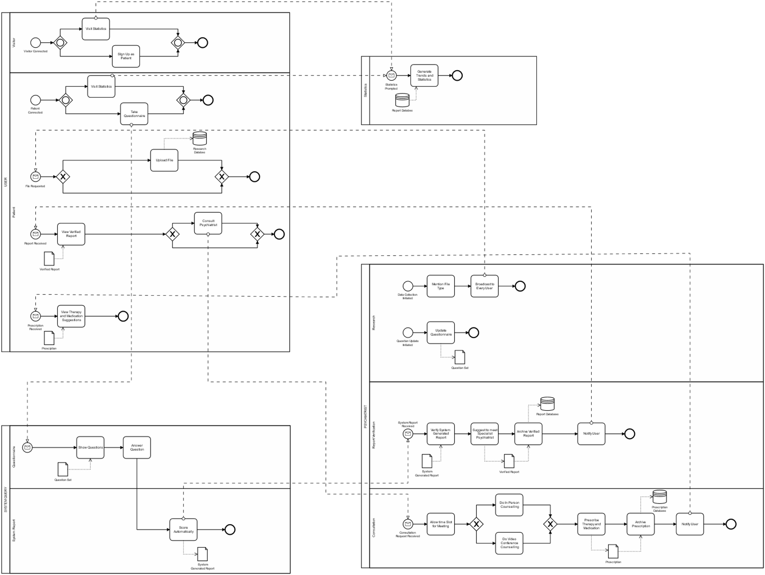
BPMN Diagram

Slide 4

Pool 1 : User

Slide 5
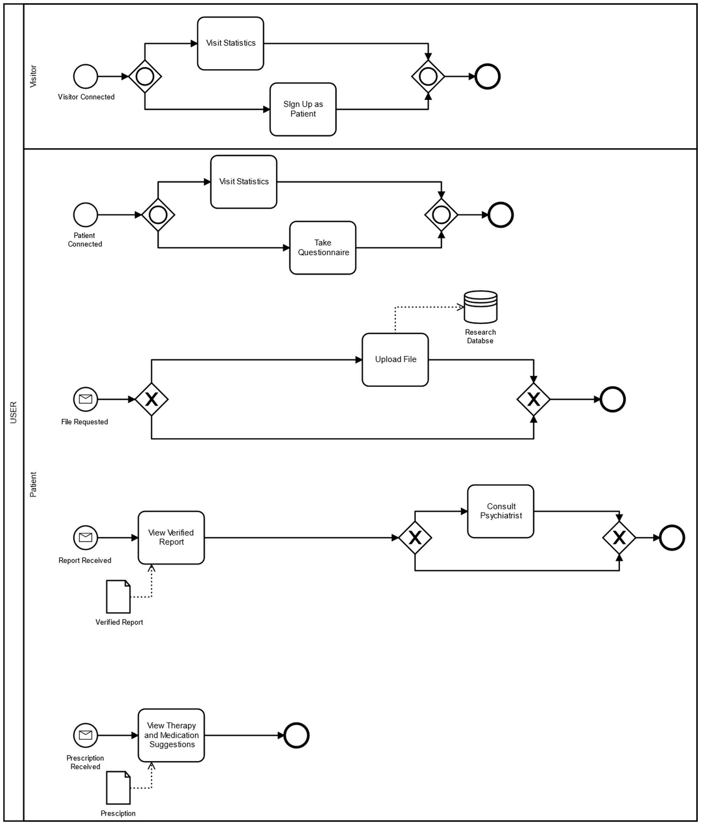
Pool 1 : User

Slide 6
Pool 2 : Psychiatrist

Slide 7
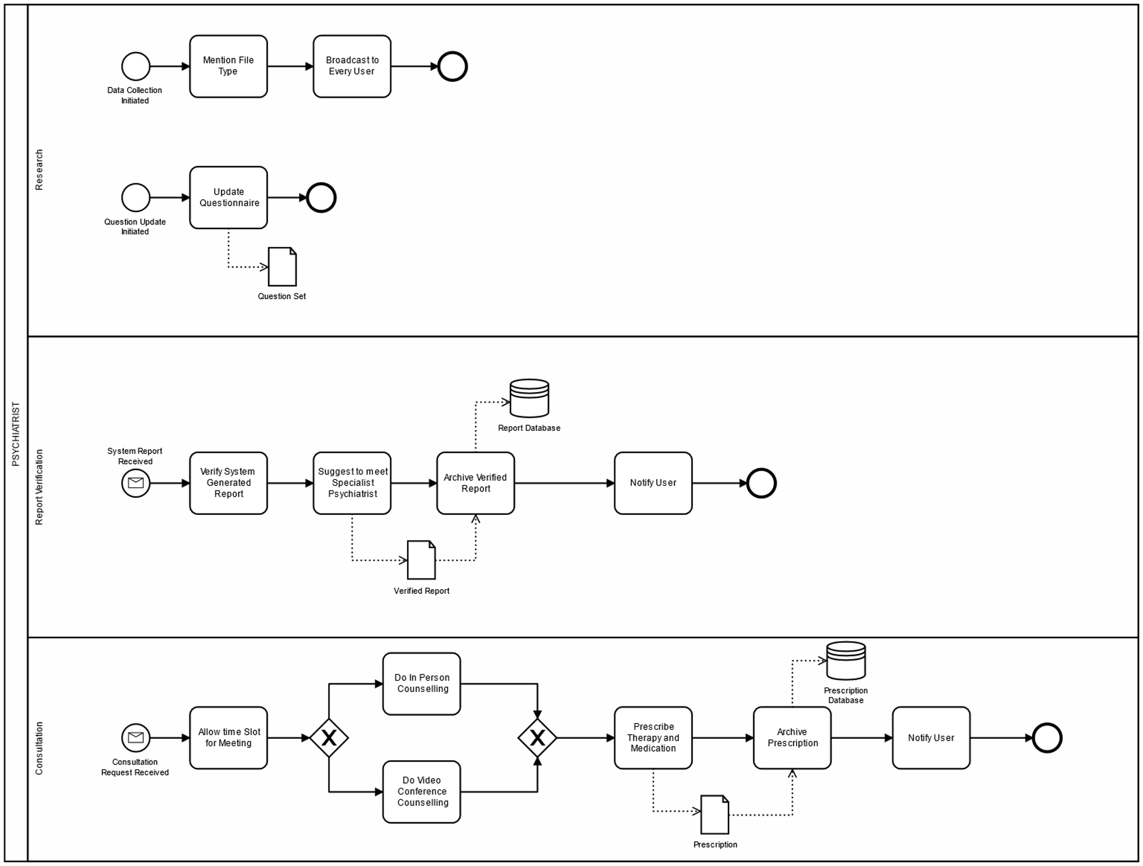
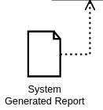
Pool 2 : Psychiatrist

Slide 8
Pool 3 : System Query

Slide 9
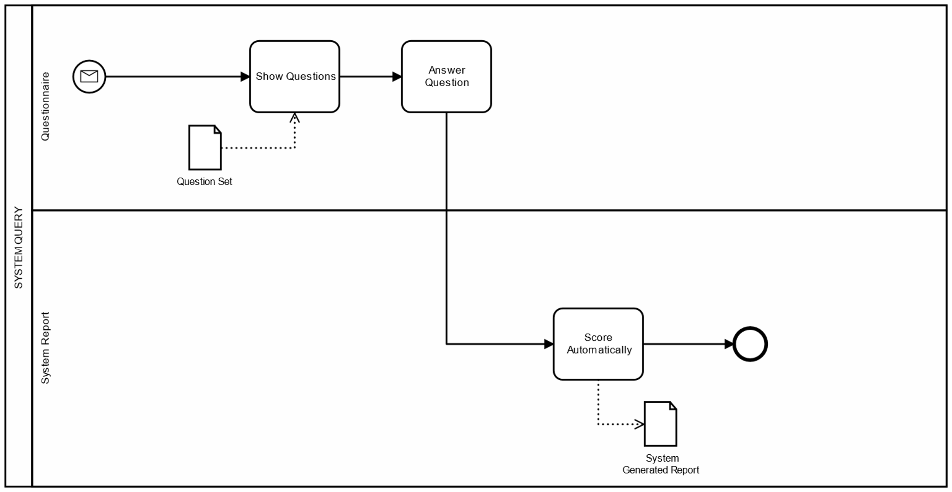
Pool 3 : System Query

Slide 10
Pool 4 : Statistics

Slide 11
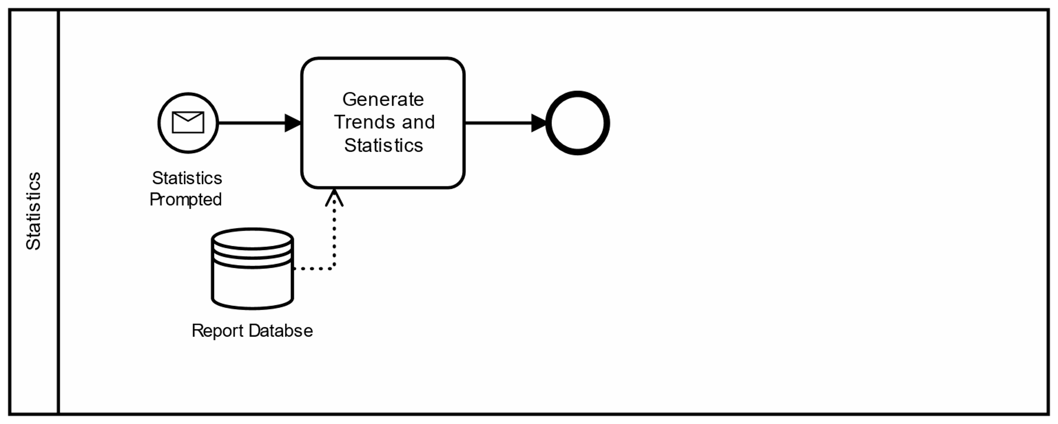
Pool 4 : Statistics

Slide 12
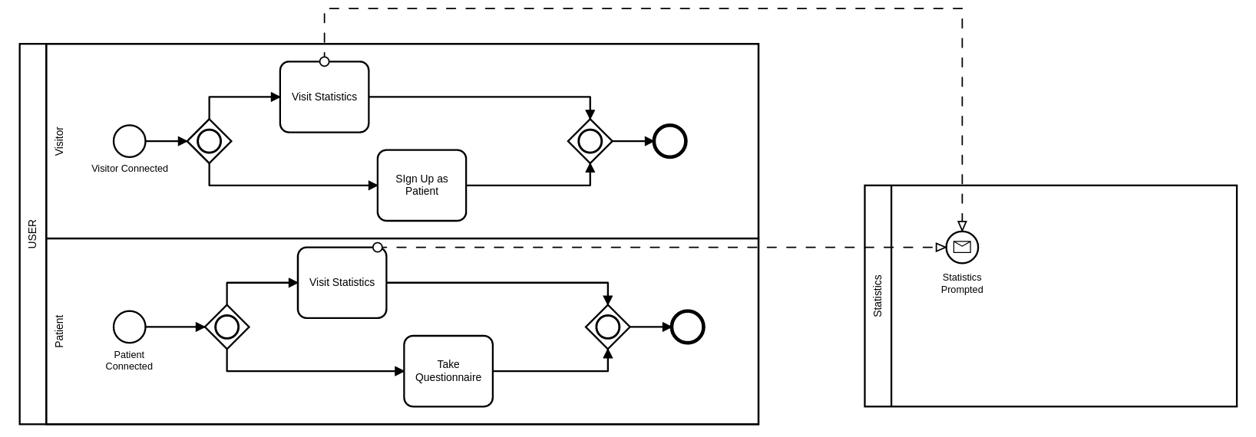
Visit Statistics

Slide 13
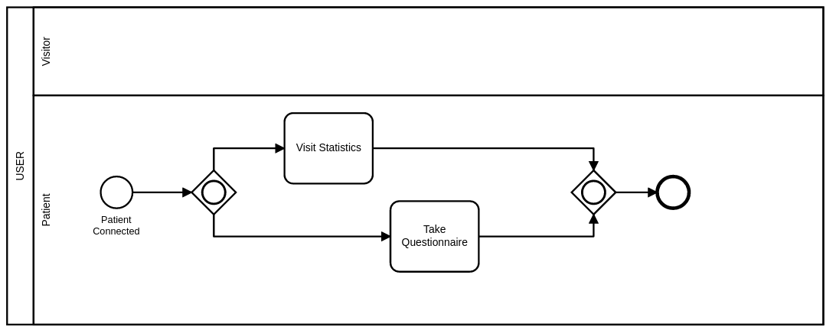
Questionnaire

Slide 14
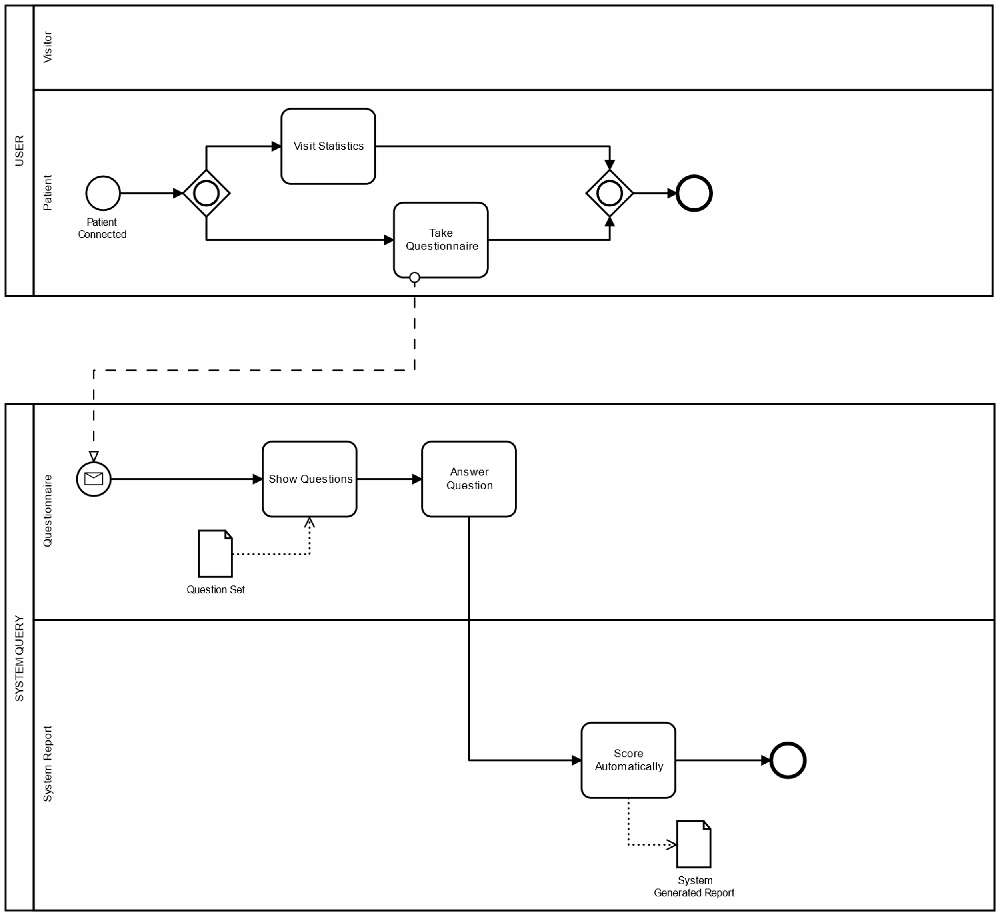
Questionnaire and System Procedure

Slide 15
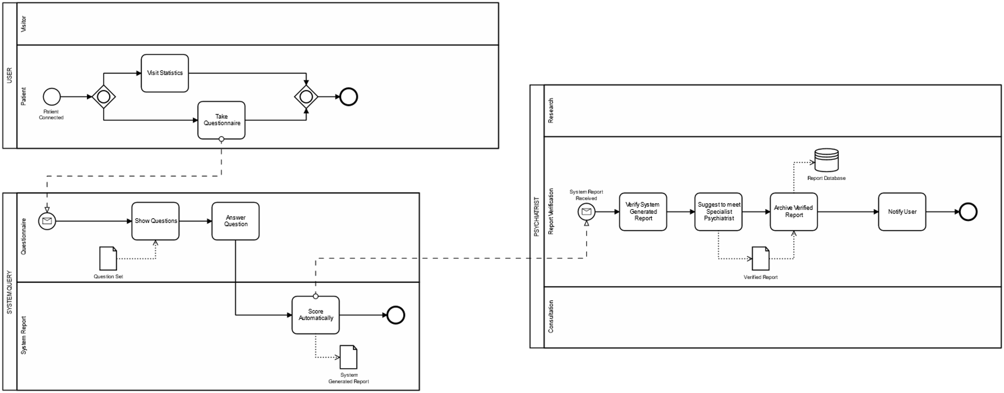
Verification of System Report

Slide 16
Verification of System Report

Slide 17
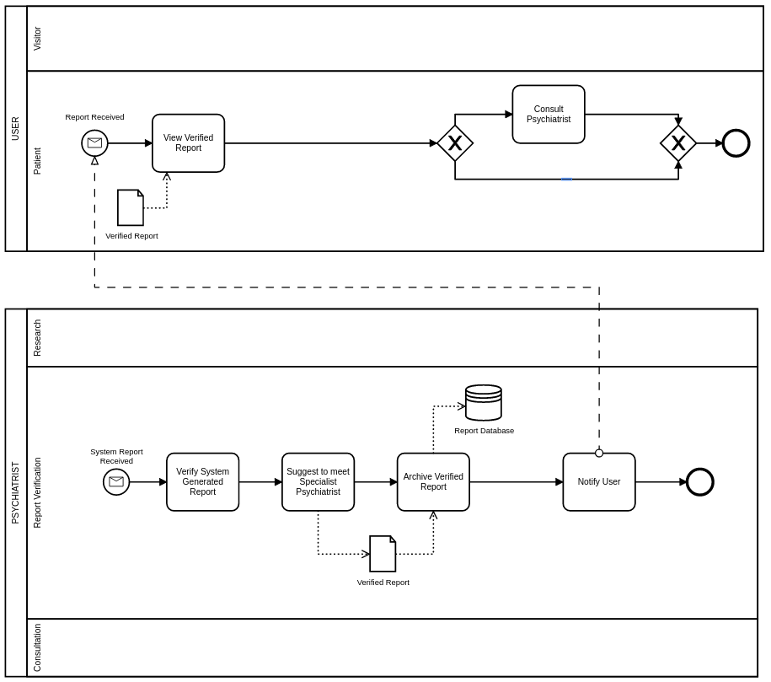
Viewing
Verified
Report

Slide 18
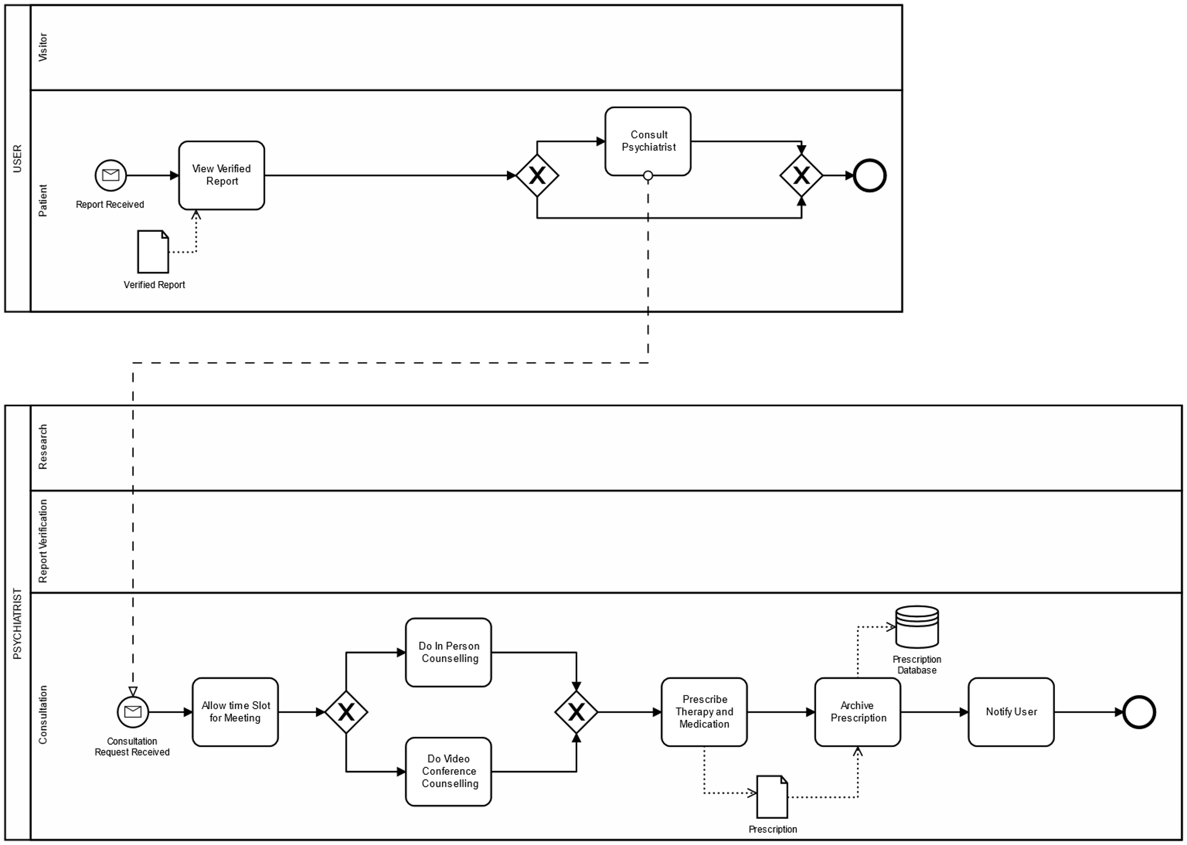
Counseling

Slide 19
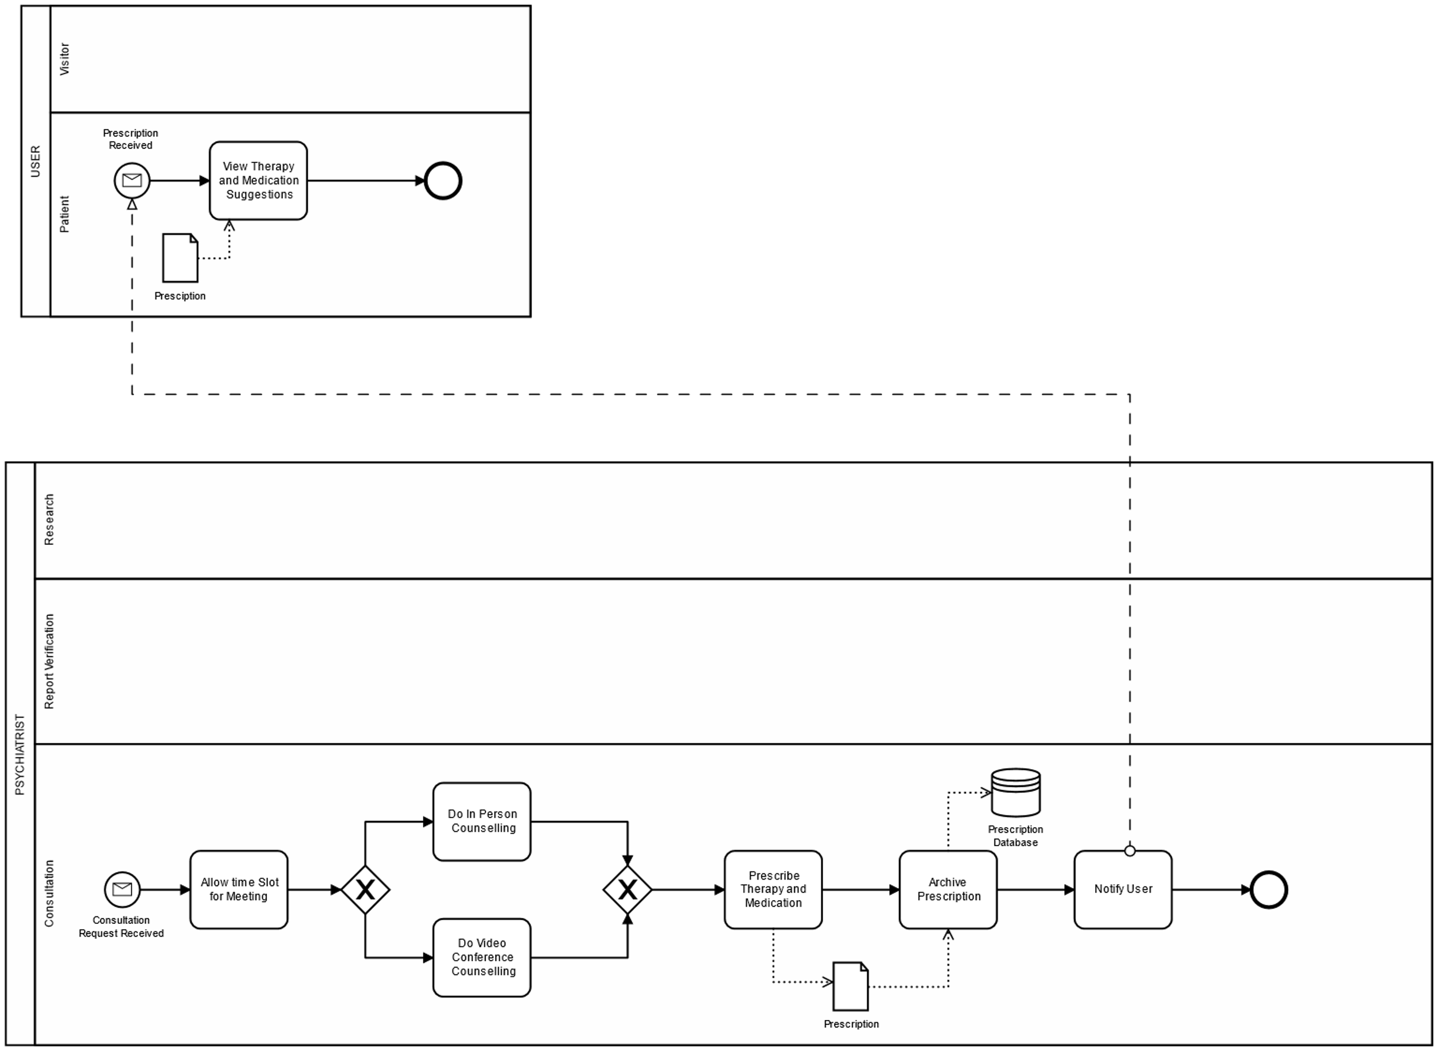
Counseling

Slide 20
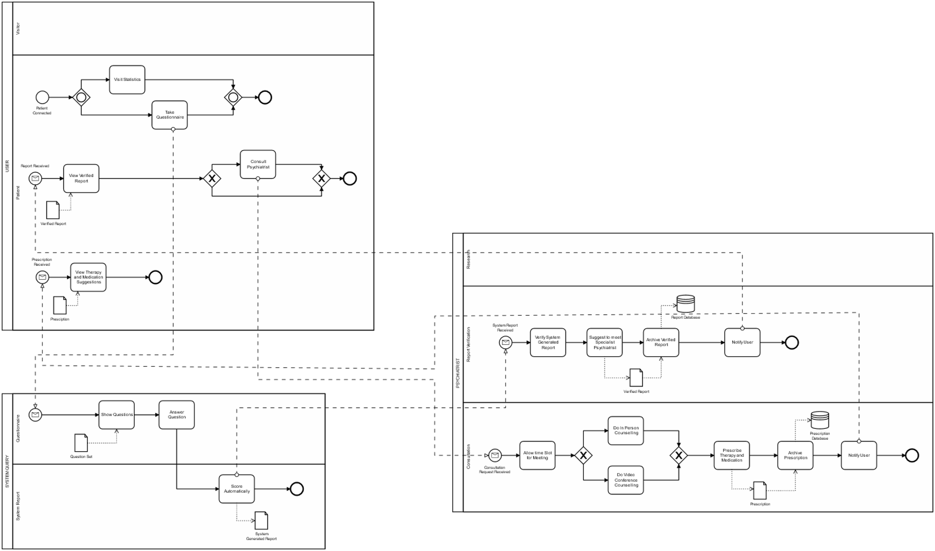
Up Until This Point

Slide 21
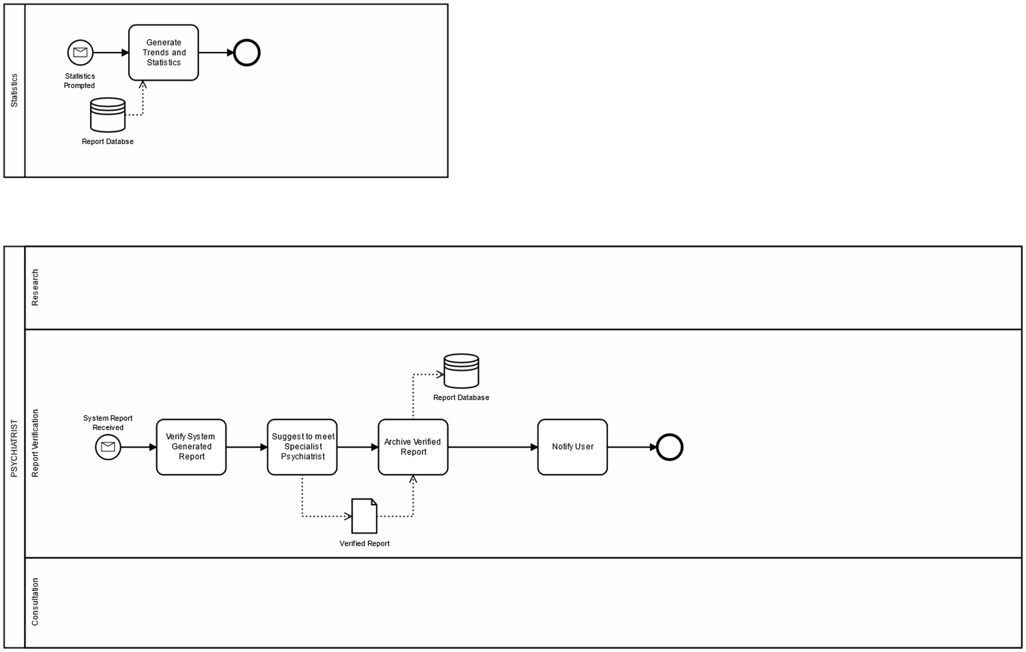
Generate Trends and Statistics

Slide 22
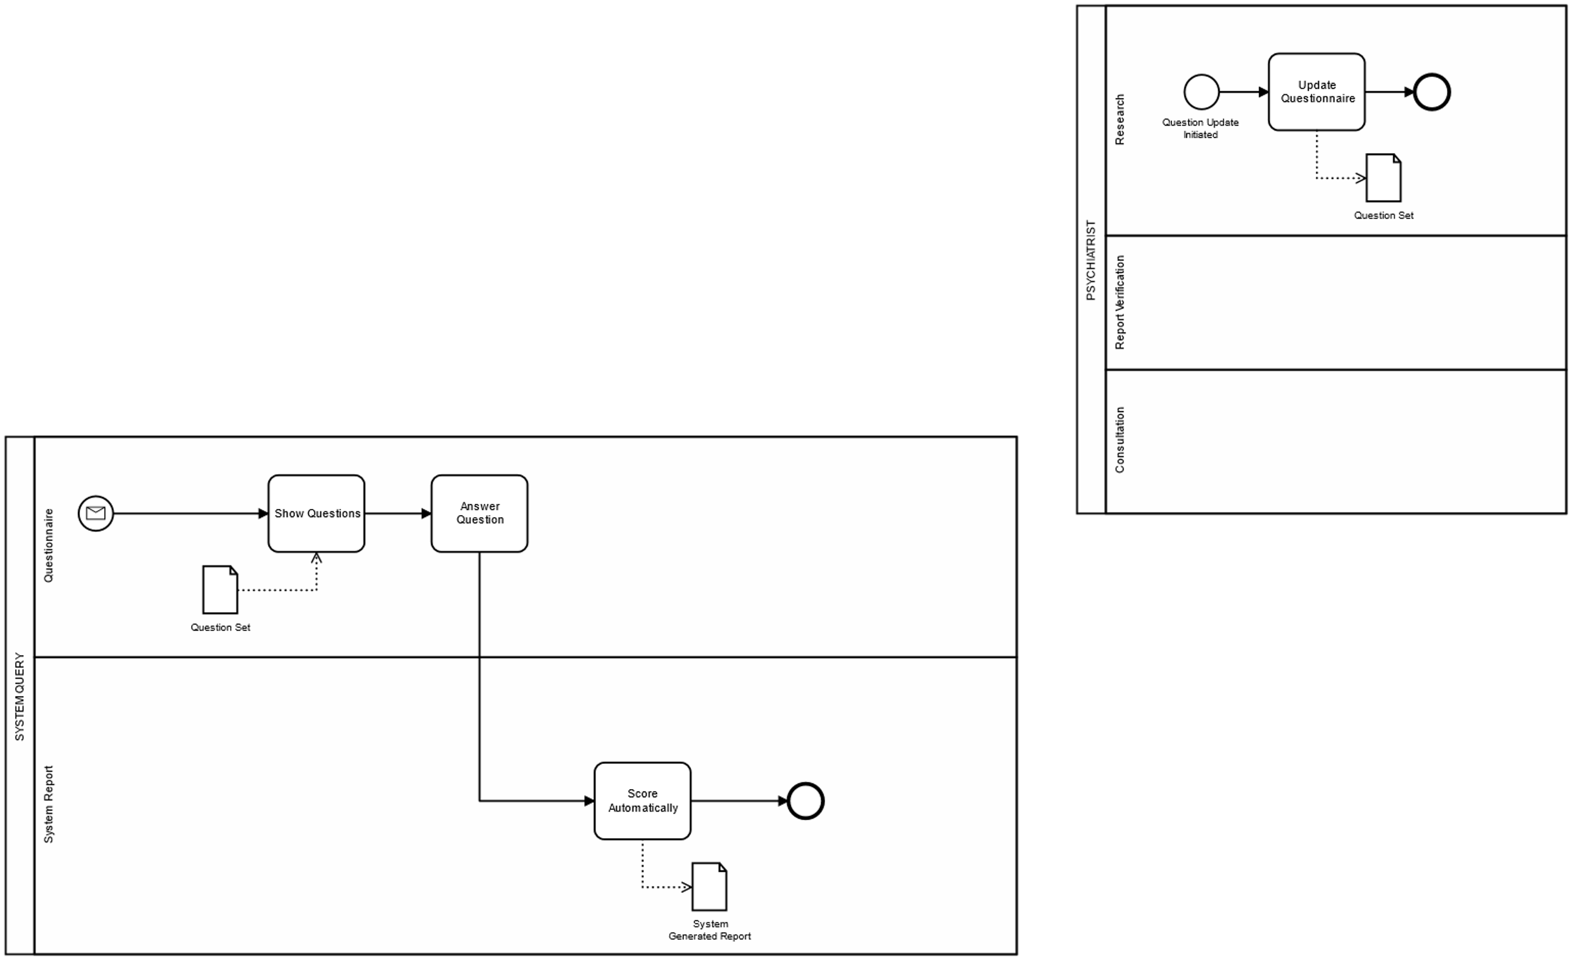
Update Questionnaire

Slide 23
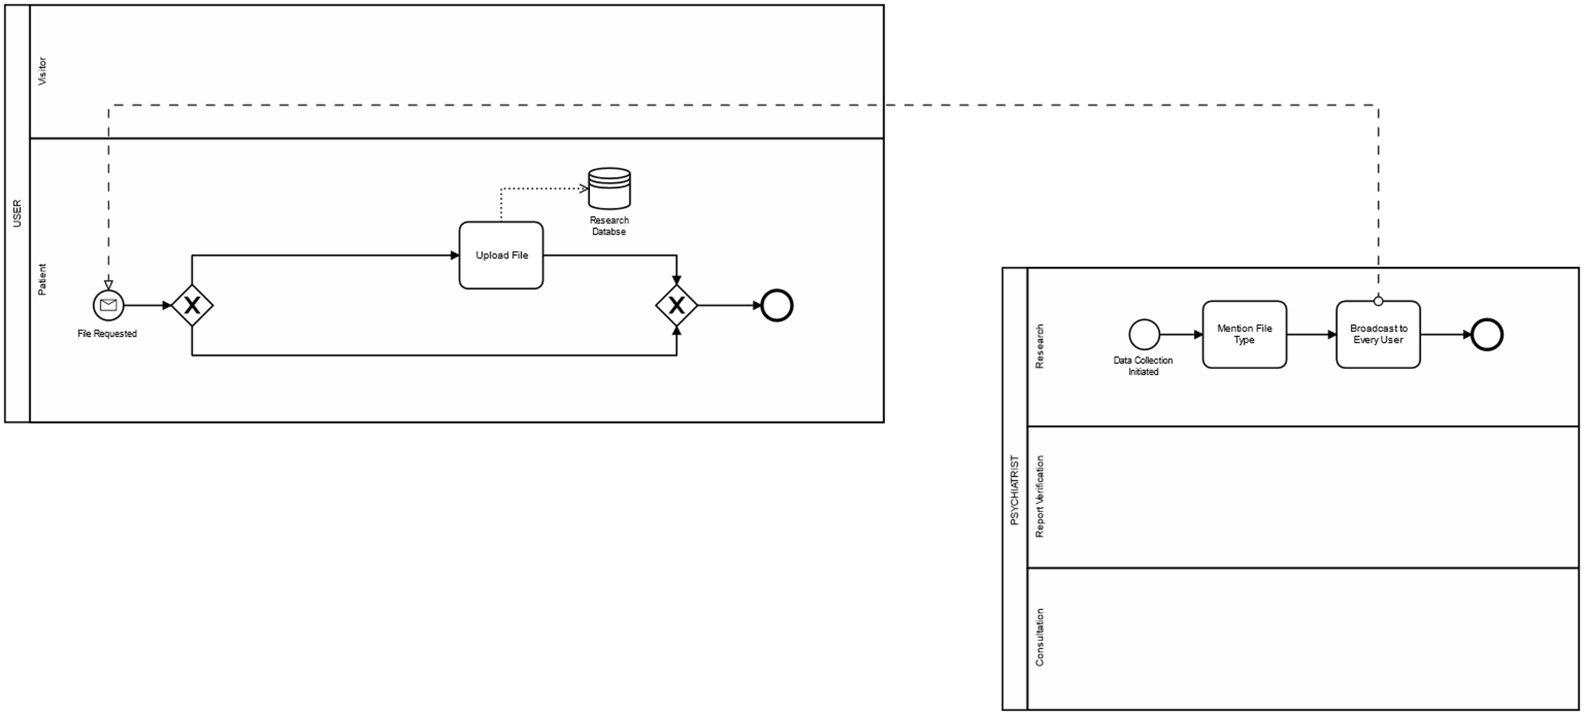
Request For File

Slide 25
Thank you all.

